Slide 1
Navigating the FutureNHS Platform
Arap Martin Memis, Nursing Workforce Project Coordinator, NHSEI

Slide 2
FutureNHS Platform: Online IR Hub
What is the FutureNHS Platform
The FutureNHS Platform, aims to empower users to co-develop, share, connect and work together more easily. The platform supports users to access and exchange knowledge and information on transformation, across health and social care. It is open to anyone working on transformational healthcare programmes across the NHS and wider health and social care family.
What is the Online International Recruitment (IR) Hub
The Online IR Hub is a private workspace for IR Leads and Facilitators to discuss and share information on international recruitment relating to nursing and midwifery. It encourages users to participate in forums and create new discussion streams to help answer questions or provide support to others.

Slide 3
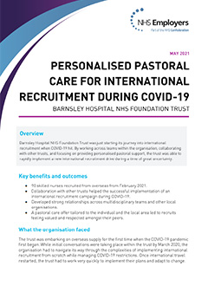
What’s on the workspace?
Good practice examples from NHS Trusts.
Discussion forums where users can exchange ideas and opinions.
PowerPoint slides and video recordings from webinars.
Tools and resources to support in leading and delivering international recruitment.
Latest news, guidance and updates on international recruitment.
Upcoming international recruitment events.

Slide 4
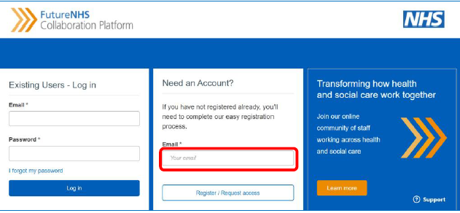
How to access the Online IR Hub: FutureNHS Platform
If you already have an FutureNHS account, log in and click on the ‘My workspaces’ dropdown. Select ‘Find a Workspace’ and search for ‘International Recruitment’.
Amend the email notification settings before you join and once your request has been approved you will receive a welcome email to confirm you are now a member.
How to register
If you’re not already a member, visit https://future.nhs.uk and follow the steps to register. Make sure you fill in all the mandatory fields marked with an * and that you read all the information.
An email containing an activation link will be sent to you. If you don’t receive this, check your junk mail folder. Once you’ve activated your account, follow the steps above to join the Online IR Hub.
Need help?
If you have any questions or you're unable to register, please contact the Nursing and Midwifery International Recruitment Team via nhsi.workforce@nhs.net

